Slide 1

VHDL – A Hardware Modeling Language
Dr. Shubhajit Roy Chowdhury,
Centre for VLSI and Embedded Systems Technology,
International Institute of Information Technology, Hyderabad
Email: src.vlsi@iiit.ac.in
CVEST, IIIT Hyderabad, India

Slide 2
The Design Process
We ask ourselves the question:
What is electronic Design?
Given specifications, we want to develop a circuit by connecting known devices such that the given specifications are met.
“Specifications” refer to the description of the (desired) behaviour of the circuit.
CVEST, IIIT Hyderabad, India

Slide 3
Electronic Design
So electronic design is the process of converting a behavioural description (what happens when …) to a structural description (what is connected to what etc.)
Apart from structural design, we need to do physical design, which involves choosing device sizes, placement, routing interconnects etc.
CVEST, IIIT Hyderabad, India

Slide 4
A typical Digital Hardware design flow
Requirements
Timing, Area,
Power
Behavioral Model
Functional Simulation
VHDL/Verilog
RTL Model
RTL Simulation
Synthesis
Verify
Logic Level
Timing, Power and
Gate Level Simulation
Gate Level Netlist
Chip Area
Floorplanning
Cells
Place and Route
Verification and
Testng
Interconnect
Chip Fabrication
Post Silicon Validation

Slide 5

Conquest over complexity
The main challenge for modern electronic design is that the circuits we want to design are extremely complex.
(In a few years, the complexity of circuits will become comparable to that of living systems!)
While technology has moved at a rapid pace, capabilities of human brain have remained the same.
Systematic methods must be developed to conquer complexity.
CVEST, IIIT Hyderabad, India

Slide 6
Take a page out of
Software designers’ book!
We must learn from our experience in developing complex software.
Hierarchical design
Modular architecture
Text based, rather than pictorial description
Reuse of existing resources
CVEST, IIIT Hyderabad, India

Slide 7
But Hardware is different!
Hardware is concurrent (all modules work at the same time) – whereas (traditional) software is sequential (execute an instruction at a time).
Hardware behavior has timing as an integral part. (Traditional) software is not timing sensitive.
CVEST, IIIT Hyderabad, India

Slide 8
Hardware Description Languages
Need the ability to
Describe
Simulate
at Behavioural
Structural and
Mixed level
And to
Synthesize
CVEST, IIIT Hyderabad, India

Slide 9
Top-down approach
The designer
Repeatedly decomposes the system-level specifications into groups and subgroups of simpler tasks.
2. The lowest-level tasks are implemented in silicon with standard circuits that have been previously designed and tested (Standard Cells)
CVEST, IIIT Hyderabad, India

Slide 10
The Bottom-up Approach
The designer starts at the transistor or gate level and designs sub-circuits of increasing complexity.
2. These are interconnected to realize the required functionality.
Top-down approach is better suited for digital design, bottom-up for analog.
Combination of both is the usual mode.
CVEST, IIIT Hyderabad, India

Slide 11
The Two Approaches
Top Down
Speed
Bottom Up
Accuracy
CVEST, IIIT Hyderabad, India

Slide 12
Algorithmic and System Design
A formal description in HDL.
Simulator to detect errors in specifications.
Synthesizer to generate equivalent logic netlist.
Hierarchical FSMs.
Hardware-software codesign.
Formal verification etc.
CVEST, IIIT Hyderabad, India

Slide 13
Structural and Logic Design
Netlist from synthesis or schematic editor.
Simulator to detect errors in design.
Fault simulation.
Automatic test vector generation etc.
CVEST, IIIT Hyderabad, India

Slide 14
Transistor Level Design
High usage of simulation tools, depending on the
accuracy needed.
Switch: digital + signal strengths + capacitances.
Timing: analog + piecewise linear transistor models.
Circuit: accurate transistor models in terms of nonlinear differential equations.
CVEST, IIIT Hyderabad, India

Slide 15
Layout Design
Partioning keeps tightly connected subblocks in the same place and helps in floorplanning and placement.
Floorplanning and Placement assigns space to each subblock.
Routing generates wiring patterns for correct interconnections and aims for minimal area.
Design Rule Checkers for checking mask geometries.
Circuit Extractors are used for extracting the final circuit from the masks layout, and then simulated for verifying the functionality.
CVEST, IIIT Hyderabad, India

Slide 16
Importance of Simulation in VLSI Design Flow
Simulation programs are tools for verifying IC design at different stages.
They enable us to verify functionality and timing of the chip before fabrication (saving time and cost) and allow easy modification of circuit components .
CVEST, IIIT Hyderabad, India

Slide 17
Why simulation?
Modern day VLSI circuits contain thousands of thousands of transistors.
P-III processor contains 65 million transistors, Itanium 320 million!
Traditional “Breadboard” method fails for VLSI (or even LSI and MSI) circuits.
God save me, my friends and my company, if an IC is fabricated only to be discovered during the test phase that the design is faulty!
70% of the total cost is in the design stage, i.e. before the silicon goes to the furnace.
CVEST, IIIT Hyderabad, India

Slide 18
VHDL
VHDL = VHSIC Hardware Description Language,
VHSIC = Very High Speed Integrated Circuit.
Using VHDL, one can design, simulate and synthesize.
Concurrency, timing and clocking can all be modeled.
Can handle asynchronous as well as synchronous sequential circuits.
Logical operation and timing behavior can be simulated.

Slide 19
VHDL Based Design Flow
Hierarchy
Coding
Compile
Simulate
/Verify
Front end
Back end
Timing
Verification
Synthesis
Place
+
Route
CVEST, IIIT Hyderabad, India

Slide 20
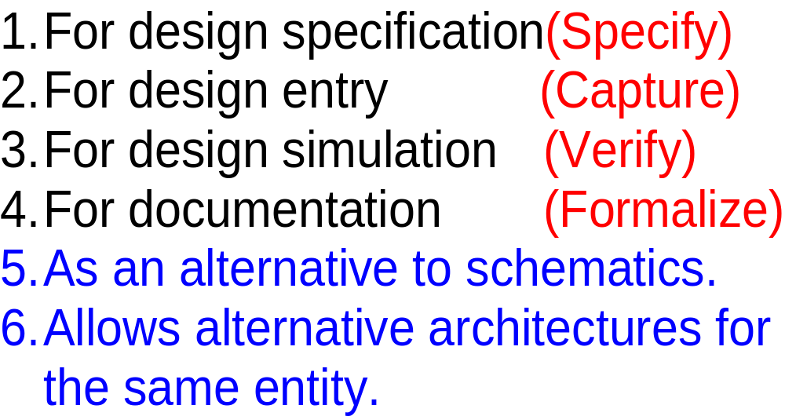
Use of VHDL
Specify
Capture
Verify
Formalize
Implement

Slide 21
Entities and Architecture
Entity
  External view: Pin-out description, Interface description, I-O port definition etc
Architecture
  Internal view
    Structural description: Gates, wires etc.
    Behavioral description: functions, procedures, RTL description
4
Din
ENTITY mux
ARCHITECTURE
Dout
2
sel

Slide 22
Ports
Pass information through the interface which is time-varying.
Are signal objects
  connected together by signals
  used to pass values between concurrently active units.
CVEST, IIIT Hyderabad, India

Slide 23
Interface Modes
Represent direction of value flow
In entities, components, and blocks the modes may be:
  IN within the design unit (both entity and body) the value may be read, but not written.
  OUT within the design unit (both entity and body) the value may be written, but not read.
  INOUT within the design unit (both entity and body) the value may be both read and written.
CVEST, IIIT Hyderabad, India

Slide 24
Modeling Interfaces
Entity declaration
  describes the input/output ports of a module
entity name
port names
port mode (direction)
entity reg4 is
port ( d0, d1, d2, d3, en, clk : in bit;
q0, q1, q2, q3 : out bit );
end entity reg4;
punctuation
reserved words
port type
CVEST, IIIT Hyderabad, India

Slide 25
VHDL-87
Omit entity at end of entity declaration
entity reg4 is
port ( d0, d1, d2, d3, en, clk : in bit;
q0, q1, q2, q3 : out bit );
end reg4;
CVEST, IIIT Hyderabad, India

Slide 26
Format of an Architecture
architecture identifier of entity_identifier is
-- local declarations, typically signals
begin
-- concurrent statements
end identifier ;
CVEST, IIIT Hyderabad, India

Slide 27
Three Styles of Modeling
Structural Modeling
Behavioral Modeling
Dataflow Modeling
CVEST, IIIT Hyderabad, India

Slide 28
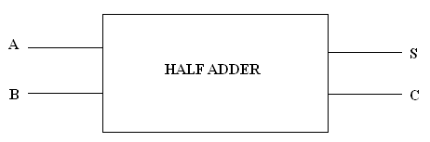
The Half Adder Example
entity ha is
port (A, B: in std_logic;
S,C: out std_logic);
end ha;
CVEST, IIIT Hyderabad, India

Slide 29
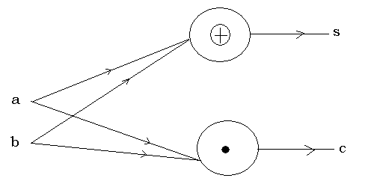
Dataflow Modeling
architecture df of ha is
begin
s<=a xor b;
c<=a and b;
end df;
CVEST, IIIT Hyderabad, India

Slide 30
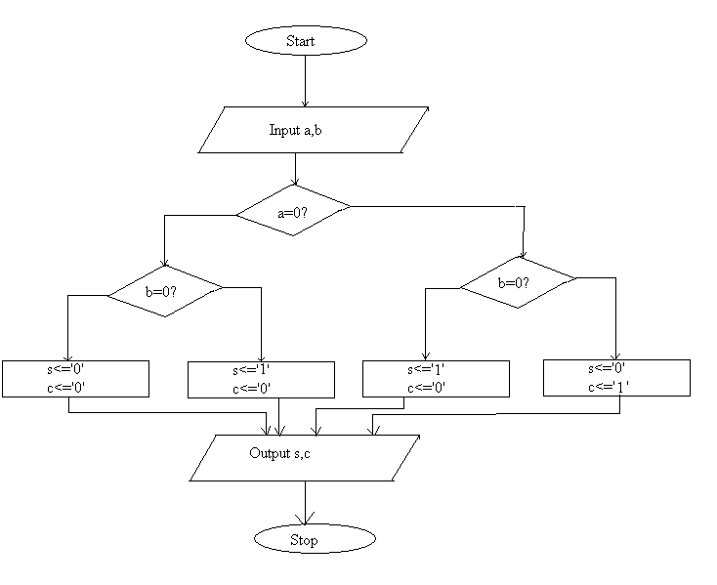
Behavioral Modeling
architecture behave of ha is
begin
process(a,b)
if (a=’0’)then
c<=’0’;
if(b=’0’)then
s<=’0’;
elsif(b=’1’)then
s<=’1’;
end if;
elsif(a=’1’)then
if(b=’0’)then
s<=’1’;
c<=’0’;
else
s<=’1’;
c<=’1’;
end behave;
CVEST, IIIT Hyderabad, India

Slide 31
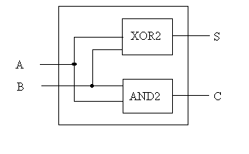
Structural Modeling
architecture struct of ha is
component AND2 is
port(P,Q:in std_logic;
R:out std_logic);
end component;
component XOR2 is
port(X,Y:in std_logic;
Z:out std_logic);
end component;
begin
X1:XOR2 port map (a,b,s);
A1:AND2 port map (a,b,c);
end struct;
CVEST, IIIT Hyderabad, India

Slide 32
Mixed Style of Modeling
architecture mixed of ha is
component AND2 is
port(P,Q:in std_logic;
R:out std_logic);
end component;
begin
s<=a xor b;
A1:AND2 port map (a,b,c);
end mixed;
CVEST, IIIT Hyderabad, India

Slide 33
Modeling Behaviour
Architecture body
  describes an implementation of an entity
  may be several per entity
Behavioral architecture
  describes the algorithm performed by the module
  contains
    process statements, each containing
    sequential statements, including
    signal assignment statements and
    wait statements
CVEST, IIIT Hyderabad, India

Slide 34
Behavior Example
architecture behav of reg4 is
begin
storage : process is
variable stored_d0, stored_d1, stored_d2, stored_d3 : bit;
begin
if en = '1' and clk = '1' then
stored_d0 := d0;
stored_d1 := d1;
stored_d2 := d2;
stored_d3 := d3;
end if;
q0 <= stored_d0 after 5 ns;
q1 <= stored_d1 after 5 ns;
q2 <= stored_d2 after 5 ns;
q3 <= stored_d3 after 5 ns;
wait on d0, d1, d2, d3, en, clk;
end process storage;
end architecture behav;
CVEST, IIIT Hyderabad, India

Slide 35
Modeling Structure
Structural architecture
  implements the module as a composition of subsystems
  contains
    signal declarations, for internal interconnections
      the entity ports are also treated as signals
    component instances
      instances of previously declared entity/architecture pairs
    port maps in component instances
      connect signals to component ports
    wait statements
CVEST, IIIT Hyderabad, India

Slide 36
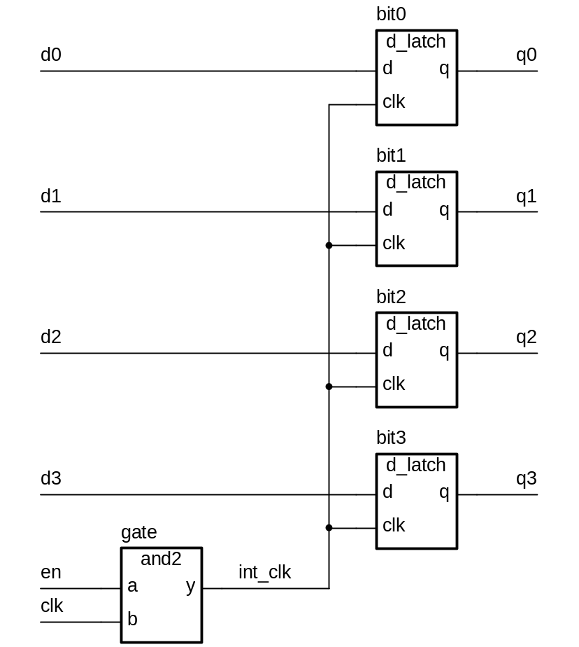
Structure Example
CVEST, IIIT Hyderabad, India

Slide 37
Structure Example
First declare D-latch and and-gate entities and architectures
entity d_latch is
port ( d, clk : in bit; q : out bit );
end entity d_latch;
architecture basic of d_latch is
begin
latch_behavior : process is
begin
if clk = ‘1’ then
q <= d after 2 ns;
end if;
wait on clk, d;
end process latch_behavior;
end architecture basic;
entity and2 is
port ( a, b : in bit; y : out bit );
end entity and2;
architecture basic of and2 is
begin
and2_behavior : process is
begin
y <= a and b after 2 ns;
wait on a, b;
end process and2_behavior;
end architecture basic;
CVEST, IIIT Hyderabad, India

Slide 38
Structure Example
Now use them to implement a register
architecture struct of reg4 is
signal int_clk : bit;
begin
bit0 : entity work.d_latch(basic)
port map ( d0, int_clk, q0 );
bit1 : entity work.d_latch(basic)
port map ( d1, int_clk, q1 );
bit2 : entity work.d_latch(basic)
port map ( d2, int_clk, q2 );
bit3 : entity work.d_latch(basic)
port map ( d3, int_clk, q3 );
gate : entity work.and2(basic)
port map ( en, clk, int_clk );
end architecture struct;
CVEST, IIIT Hyderabad, India

Slide 39
Mixed Behaviour and Structure
An architecture can contain both behavioral and structural parts
  process statements and component instances
    collectively called concurrent statements
  processes can read and assign to signals
Example: register-transfer-level model
  data path described structurally
  control section described behaviorally
CVEST, IIIT Hyderabad, India

Slide 40
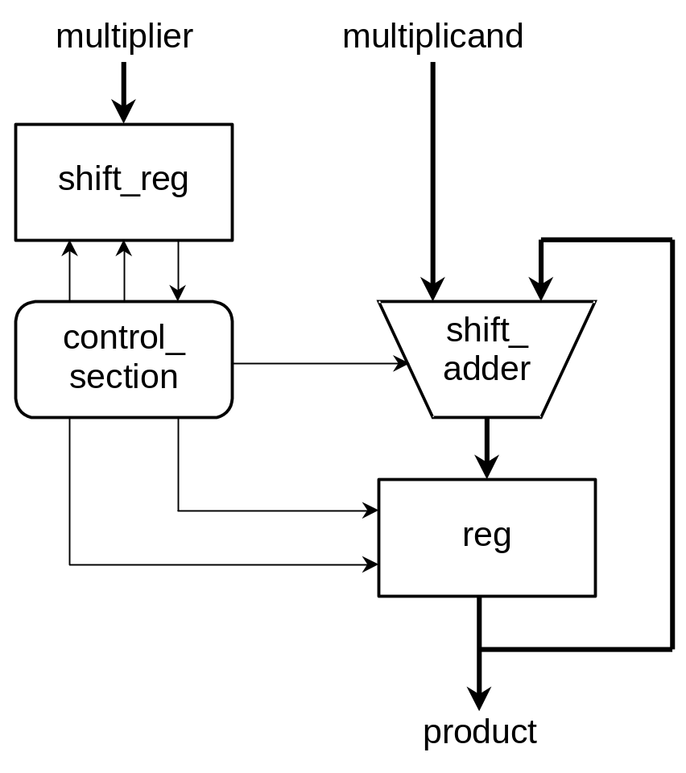
Mixed Example
CVEST, IIIT Hyderabad, India

Slide 41
Mixed Example
entity multiplier is
port ( clk, reset : in bit;
multiplicand, multiplier : in integer;
product : out integer );
end entity multiplier;
architecture mixed of mulitplier is
signal partial_product, full_product : integer;
signal arith_control, result_en, mult_bit, mult_load : bit;
begin
arith_unit : entity work.shift_adder(behavior)
port map ( addend => multiplicand, augend => full_product,
sum => partial_product,
add_control => arith_control );
result : entity work.reg(behavior)
port map ( d => partial_product, q => full_product,
en => result_en, reset => reset );
...
CVEST, IIIT Hyderabad, India

Slide 42
Mixed Example
…
multiplier_sr : entity work.shift_reg(behavior)
port map ( d => multiplier, q => mult_bit,
load => mult_load, clk => clk );
product <= full_product;
control_section : process is
-- variable declarations for control_section
-- …
begin
-- sequential statements to assign values to control signals
-- …
wait on clk, reset;
end process control_section;
end architecture mixed;
CVEST, IIIT Hyderabad, India

Slide 43
Delay Modeling using VHDL
CVEST, IIIT Hyderabad, India

Slide 44
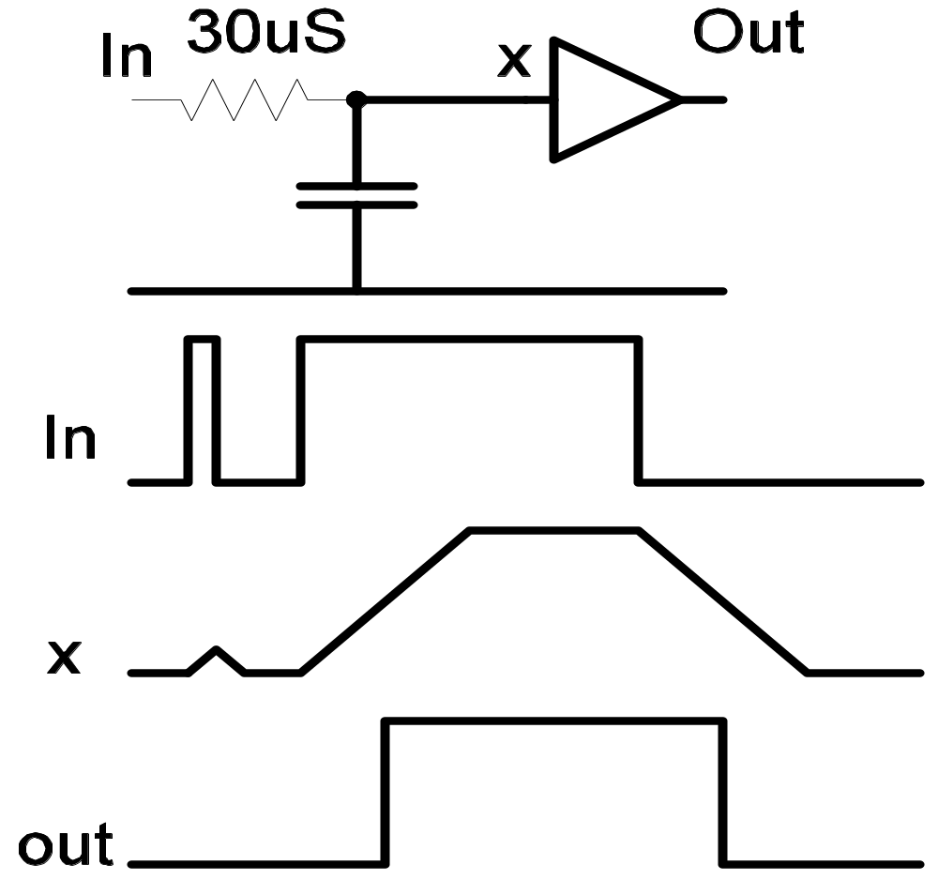
Delays in Hardware: Inertial
The narrow pulse vanishes.
CVEST, IIIT Hyderabad, India

Slide 45
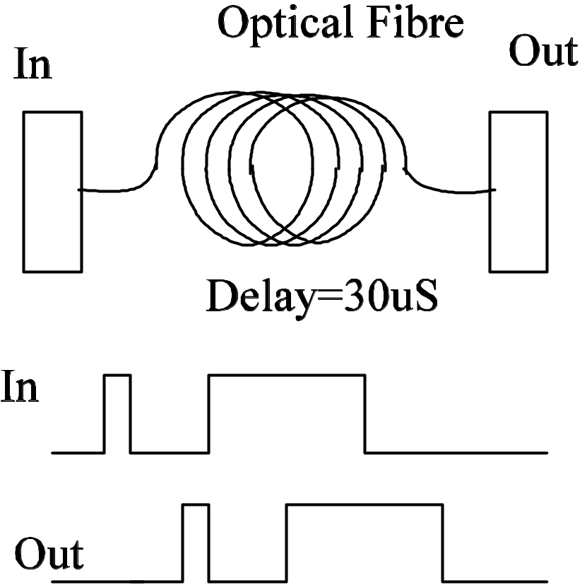
Delays in Hardware: (transport)
The narrow pulse appears in the output after the delay.
CVEST, IIIT Hyderabad, India

Slide 46
Modeling Delay
So the same amount of delay (30 uS in our example) can result in qualitatively different phenomena!
We have to define two different kinds of delay:
Inertial delay is the RC type of delay which swallows pulses which are much shorter than the delay period.
Transport delay is the optical fibre kind of delay, which allows even narrow pulses to pass through.
Delays are inertial by default. The amount of delay is taken to be 0 if not specified.
CVEST, IIIT Hyderabad, India

Slide 47
Concept of Delta Delay
When a signal assignment is made, the target signal does not acquire the assigned value immediately.
The target value is assigned after a delay. Remembering that a signal is scheduled to acquire a value after some time is called a transaction.
Thus, when an assignment is made, we imply that the target signal will acquire this value after so much delay of this type.
Default amount and type of delay is zero, inertial.
Zero delay is implemented as a small delay (δ) which goes to zero in the limit. This has scheduling implications. Events occuring at t, t+δ, t+2δ
are all reported at t, but are time ordered as if δ is non zero.
CVEST, IIIT Hyderabad, India

Slide 48
Concurrency
We handle concurrency by using an event driven architecture.
We keep track of time as a separate global variable.
Things which happen at the same time are all handled one after the other, keeping the time value the same.
We then advance the time to the next event.
Note: The time variable has nothing to do with the time taken by the simulator to run! It keeps track of the actual time at which multiple things would happen. These multiple (concurrent) things are handled in an order dictated by scheduling.
CVEST, IIIT Hyderabad, India

Slide 49
Scheduling policy
We keep a time ordered queue of signals waiting to acquire assigned values. Time is advanced to the earliest entry in this queue and all the waiting signal assignments scheduled for this time are made. If a signal value changes, we call it an event.
We keep track of all pieces of hardware which would be affected by this change. (Typically, all modules to which this signal is an input). The output of each such module is re-computed and is scheduled to appear at the output signals after appropriate delays.
These are called transactions and are inserted in the time-ordered queue.
CVEST, IIIT Hyderabad, India

Slide 50
Scheduling policy
For each event which occurs at a given time
All modules which are “sensitive to” this event are
simulated and their outputs are scheduled to acquire their
re-computed values at appropriate times in the time ordered queue.
This is repeated for each event which occurs at the current time.
When no events are left, we advance the time to the next earliest entry in the time ordered queue.
CVEST, IIIT Hyderabad, India

Slide 51
Finite State Machines
CVEST, IIIT Hyderabad, India

Slide 52
Introduction
State Machines constitute a special modeling technique for sequential circuits. Such a modeling technique can prove to be useful for certain systems especially in those whose tasks form a well defined sequence. A finite state machine is a circuit that has finite number of states and can switch between them if certain conditions exist.
CVEST, IIIT Hyderabad, India

Slide 53
Types of Finite State Machines
Mealy Machines
Mealy machines are generalized finite state machines where the output at any instant of time depends on the present state and present input.
Moore Machines
Moore machines are a restricted type of finite state machines, where the output at any instant of time depends only on the present state and not on the present input.
CVEST, IIIT Hyderabad, India

Slide 54
An Example
Problem:
Design an FSM that sets an output, z, to high when it detects a sequence of 0-1-1-0 on the input, x.
CVEST, IIIT Hyderabad, India

Slide 55
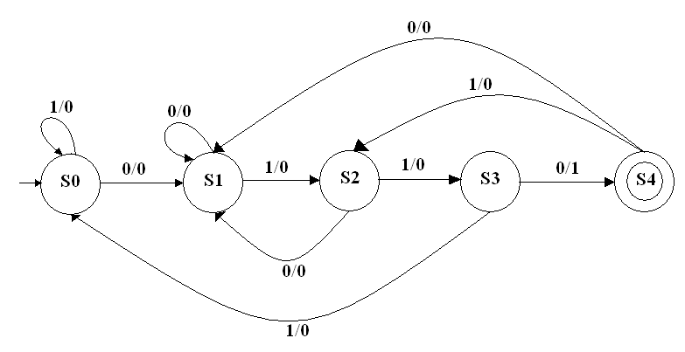
State Diagram of the Finite State Machine
CVEST, IIIT Hyderabad, India

Slide 56
VHDL Model of the FSM
library ieee;
use ieee.std_logic_1164.all;
entity finitestatemachine is
port
( reset, clk, x : in std_logic;
z : out std_logic );
end finitestatemachine;
architecture behavioral of finitestatemachine is
-- The following is an example of a user defined "enumerated" data type
type statetype is (s0, s1, s2,s3,s4);
signal state, next_state : statetype := s0;
-- -- Declaration of two signals of this type
CVEST, IIIT Hyderabad, India

Slide 57
VHDL Model of the FSM
comb_proc : process (state, x)
begin
case state is
when s0 =>
if x = '0' then
next_state <= s1;
z <= '0';
else
next_state <= s0;
z <= '0';
end if;
CVEST, IIIT Hyderabad, India

Slide 58
VHDL Model of the FSM
when s1 =>
if x = '1' then
next_state <= s2;
z <= '0';
else
next_state <= s1;
z <= '0';
end if;
when s2 =>
if x = '1' then
next_state <= s3;
z <= '0';
else
next_state <= s1;
z <= '0';
end if;
CVEST, IIIT Hyderabad, India

Slide 59
VHDL Model of the FSM
when s3 =>
if x = '1' then
next_state <= s0;
z <= '0';
else
next_state <= s4;
z <= ‘1';
end if;
when s4 =>
if x = '0' then
next_state <= s1;
z <= ‘0';
else
next_state <= s2;
z <= ‘0';
end if;
end case;
end process;
CVEST, IIIT Hyderabad, India

Slide 60
VHDL Model of the FSM
clk_proc : process
begin
wait until (clk'event and clk = '1');
-- wait for rising edge of clk
if reset = '1' then
state <= s0;
else
state <= next_state;
end if;
end process;
end behavioral;
CVEST, IIIT Hyderabad, India

Slide 61
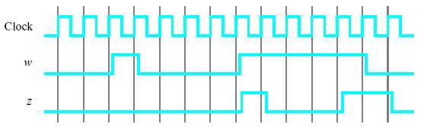
A FSM Assignment
Consider a finite state machine (FSM) that recognizes two specific sequences of applied input symbols, namely four consecutive 1s or four consecutive 0s. There is an input w and an output z whenever w = 1 or w = 0 for four consecutive clock pulses the value of z has to be 1; otherwise, z = 0. Overlapping sequences are allowed, so that if w = 1 for five consecutive clock pulses the output z will be equal to 1 after the fourth and fifth pulses. Figure 1 illustrates the required relationship between w and z.
Figure 1. Required timing for the output z.
Draw a state diagram for this finite state machine. Behaviorally model the finite state machine using VHDL. Now draw the sequential circuit corresponding to this finite state machine. Structurally model the finite state machine using VHDL.
CVEST, IIIT Hyderabad, India

Slide 62
Memory Modeling using VHDL
CVEST, IIIT Hyderabad, India

Slide 63
Array Types
TYPE bit_mem IS ARRAY (0 to 7) OF std_logic; -- one dimension
TYPE char_mem IS ARRAY (0 to 15) OF std_logic_vector(7 downto 0);
-- declaring a constant array
CONSTANT char_1 : char_mem := (X”11”, X”22”, X”33”, OTHERS =>
X”00”);
variable address : integer range 0 to 15;
-- vcount is a std_logic_vector, row counter
address := conv_integer(vcount (v2 downto v1);
shift_reg <= char_1(address);
CVEST, IIIT Hyderabad, India

Slide 64
Array Types
TYPE bit_mem IS ARRAY (0 to 7) OF std_logic; -- one dimension
TYPE char_mem IS ARRAY (0 to 15) OF std_logic_vector(7 downto 0);
-- declaring a constant array
CONSTANT char_1 : char_mem := (X”11”, X”22”, X”33”, OTHERS =>
X”00”);
variable address : integer range 0 to 15;
-- vcount is a std_logic_vector, row counter
address := conv_integer(vcount (v2 downto v1);
shift_reg <= char_1(address);
CVEST, IIIT Hyderabad, India

Slide 65
Array Types
TYPE memory IS ARRAY(0 to memsize, memwidth DOWNTO 0) OF std_logic;
SIGNAL ram : memory; -- declare array
SIGNAL z : std_logic;
-- also declaring a constant array
CONSTANT eprom : memory :=
( (‘0’, ‘0’, ‘0’, ‘0’),
(‘0’, ‘1’, ….
(‘1’, ‘1’, ‘1’, ‘1’) );
-- now using these arrays in statements
z <= eprom(6,1); -- read element at 2nd column of 7th row.
ram(2,3) <= ‘1’; -- set element of ram
CVEST, IIIT Hyderabad, India

Slide 66
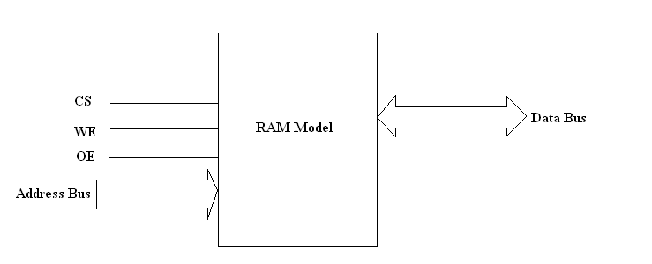
Basic Memory Model
CVEST, IIIT Hyderabad, India

Slide 67
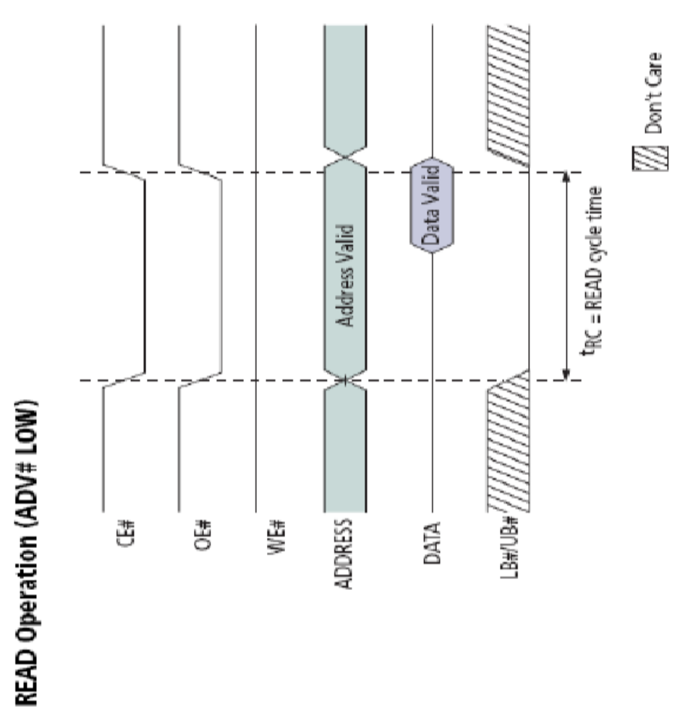
SRAM - Simplified Read Operation
CVEST, IIIT Hyderabad, India

Slide 68
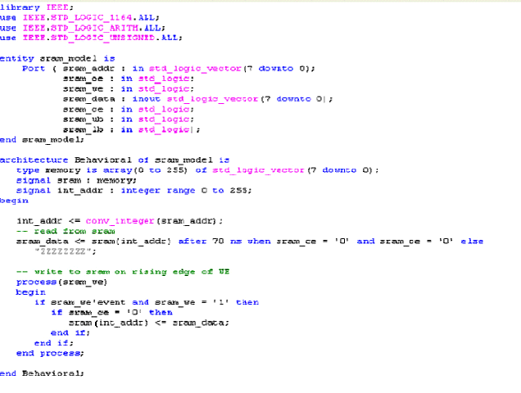
VHDL Program of the SRAM
CVEST, IIIT Hyderabad, India

Slide 69
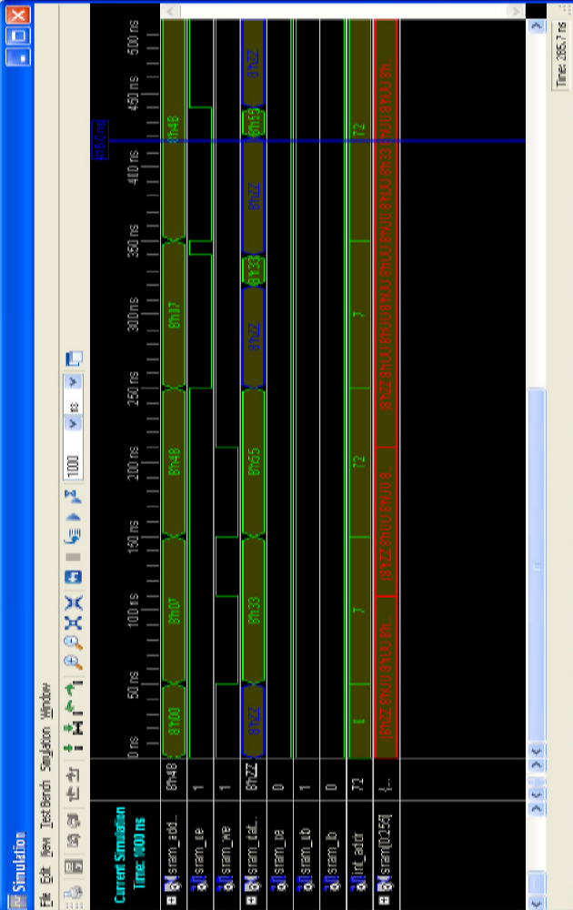
Simulation Results
CVEST, IIIT Hyderabad, India

Slide 70
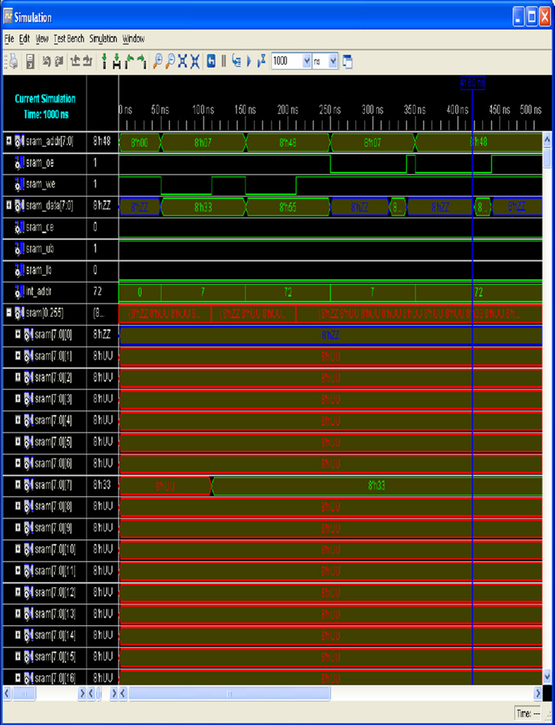
Viewing the array
CVEST, IIIT Hyderabad, India

Slide 71
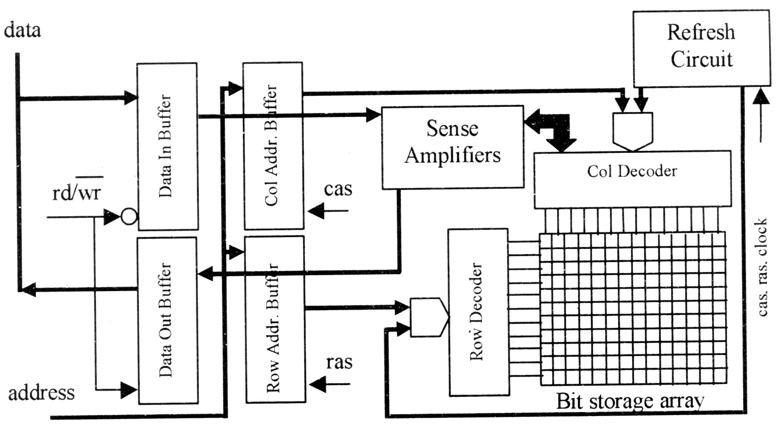
Basic DRAM Architecture
CVEST, IIIT Hyderabad, India

Slide 72
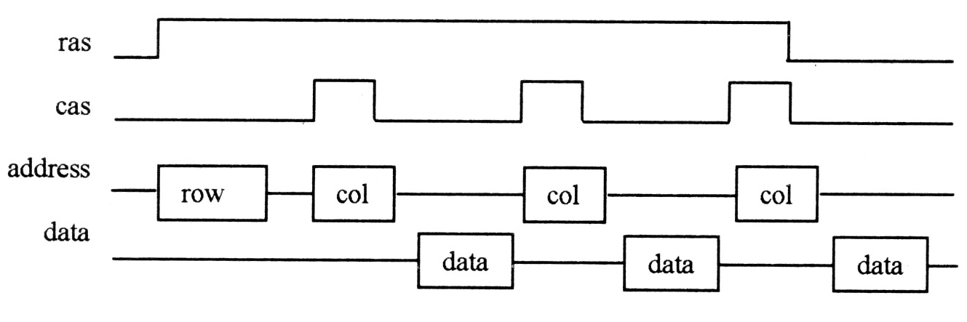
Fast Page Mode DRAM (FP DRAM)
A row is selected and the col. addresses are sequenced. A row is considered a page, consisting of multiple words.
Each word has a sep. col. address.
The sense amplifier buffers a page.
CVEST, IIIT Hyderabad, India

Slide 73
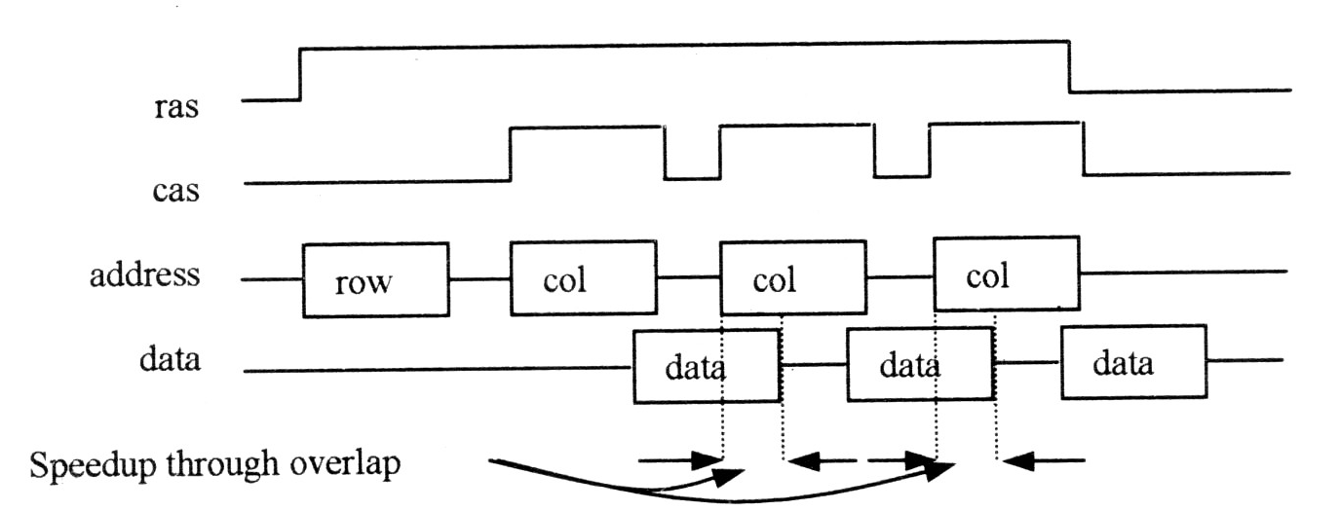
EDO DRAM (Extended Data Out DRAM)
-- Extra output latch between the sense ampl. and output buffer
-- allows overlap bet. Col. Select and previous data out
-- saves one cycle over FP DRAM
CVEST, IIIT Hyderabad, India

Slide 74
SDRAM
FPM and EDO RAM controlled asynchronously by the processor or the memory controller.
A synchronous DRAM interface will eliminate a small amount of time (thus latency) that is needed by the DRAM to detect the ras/cas and rd/wr signals. DRAM latches information to and from the controller on the active edge of the clock signal
In addition to a lower latency I/O, after a proper page and column setup, an SDRAM may store the starting address internally and output new data on each active edge of the clock signal, as long as the requested data are consecutive memory locations. This is accomplished by adding a column address counter to the base DRAM architecture. This counter is seeded with a starting column address strobed in by the processor (or memory controller) and is thereafter incremented internally by the DRAM on each clock cycle.
CVEST, IIIT Hyderabad, India

Slide 75
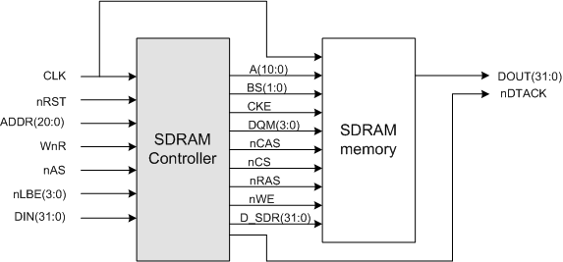
Model of an SDRAM
CVEST, IIIT Hyderabad, India

Slide 76
Interface signals of SDRAM
signal | name | active | I/O | description
CLK | clock | N/A | input | system clock
nRST | reset | low | input | system reset
ADDR(20:0) | memory address | N/A | input | memory address for r/w access
WnR | access type | N/A | input | when low read transfer, when high write tran.
nAS | address and data strobe | low | input | starts transfer
nLBE(3:0) | input mask for data | low | input | input enable/disable for data
DIN(31:0) | data input | N/A | input | data to be written into sdram
A(10:0) | address bus | N/A | output | address or control signals into sdram
BS(1:0) | bank select | N/A | output | determines bank to which commands are executed
CKE | clock enable | high | output | sdram CKE input
DQM(3:0) | data mask | high | output | sdram data masks, mask individual bytes during data write.
nCAS | column address strobe | low | output | sdram nCAS input
nCS | chip select | low | output | sdram chip select
nRAS | row address strobe | low | output | sdram nRAS input
nWE | write enable | low | output | sdram nWE input
nDTACK | transmission acknowledge | low | output | acknowledges data transfer, strobe for data output from sdram
DATA_OUT_SDR | data bus | N/A | output | sdram data in bus

Slide 77
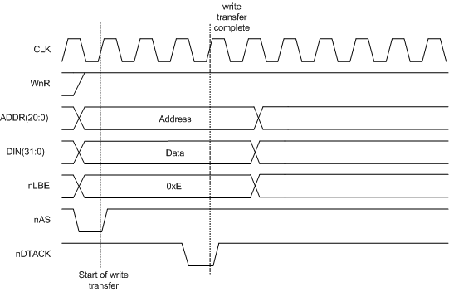
The write access
CVEST, IIIT Hyderabad, India

Slide 78
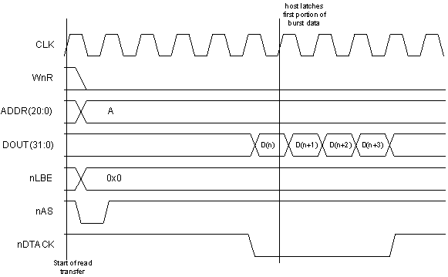
The read access
CVEST, IIIT Hyderabad, India

Slide 79
Asynchronous Sequential Logic
CVEST, IIIT Hyderabad, India

Slide 80
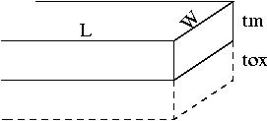
Interconnect Delay
R= ρ L /(w tm) C = ε Lw / tox
Delay = RC = ρε L² /(tm tox)
Local interconnect: L, tm, tox scaled down by the same factor
=> Delay is scaling invariant
Global wires: L↑ (Bigger chip), tm and tox ↓ (scaled down).
=> increase of delay time by 1/S³ (S = scaling factor: ≈0.7).
CVEST, IIIT Hyderabad, India

Slide 81
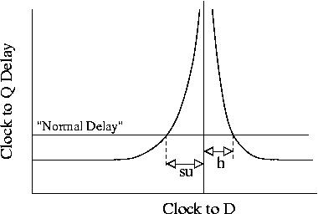

Metastability
A Latch has “normal” clock to Q delay if the data stays stable in a time window around the clock transition.
Data must not change a setup time before and a hold time after the clock event.
CVEST, IIIT Hyderabad, India

Slide 82
Flop Timing Spec
Clock
Input Constraints
t_{SU}
t_{H}
Output Spec
t_{pCQ}
CVEST, IIIT Hyderabad, India

Slide 83
What Happens After Metastability?
Flop goes to 1 or 0 in random.
Not related to input.
Happens due to noise.
Happens relatively fast (exponential probability).
However, still very dangerous !
CVEST, IIIT Hyderabad, India

Slide 84
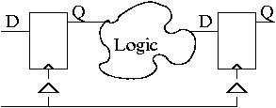
Synchronous Design
Δ1+Skew1 + Ck_to_Q + Logicmax < T + Δ2 – Skew2 – Setup
Δ1 - Skew1 + Ck_to_Q + Logicmin > Δ2 + Skew2 + Hold
This represents a two sided constraint on logic delay and for some values of skew, Δ, Setup, Hold and T, the range of allowed values may be null!
CVEST, IIIT Hyderabad, India

Slide 85
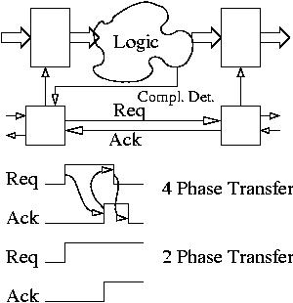
Asynchronous Design

Slide 86
Req-Ack Signaling
Push System
  Talker initiates: drives Req, Listener terminates by driving Ack
Pull System
  Listener initiates: Drives Req, Talker terminates by driving Ack
Master-Slave
  Master initiates with Req, indicates direction of transfer by another line. Slave responds by Ack.
CVEST, IIIT Hyderabad, India

Slide 87
Synchronous vs. Asynchronous
Synchronous circuits
  Time is discrete
  A special global signal called clock
Asynchronous circuits
  Time is continuous
  No clock
CVEST, IIIT Hyderabad, India

Slide 88
Why use Asynchronous Circuits
(Often cited top 10 list from Al Davis, Async 94)
Achieve average case performance
Consume power only when needed
Provide modular composition
Do not require clock alignment at interfaces
Metastability has time to resolve
No Clock Distribution Problems
CVEST, IIIT Hyderabad, India

Slide 89
Reasons for using Asynchronous circuits
Exploit Concurrency more gracefully
  Natural way to describe systems with lots of concurrency
Provide Intellectual Challenge!
  Lots of good puzzles!!
Exhibit intrinsic elegance
Global Synchrony does not exist anyway!
CVEST, IIIT Hyderabad, India

Slide 90
Disadvantages of Asynchrony
Difficult to design and verify
  Need to look at dynamic state of circuit
  Need to eliminate hazards
Inadequate CAD tools
Reluctance to step out of well-established synchronous paradigm
Overheads – in area, speed, power – because of extra circuitry to ensure correctness
CVEST, IIIT Hyderabad, India

Slide 91
So whats the solution?
THINK
CVEST, IIIT Hyderabad, India

